Slide 1
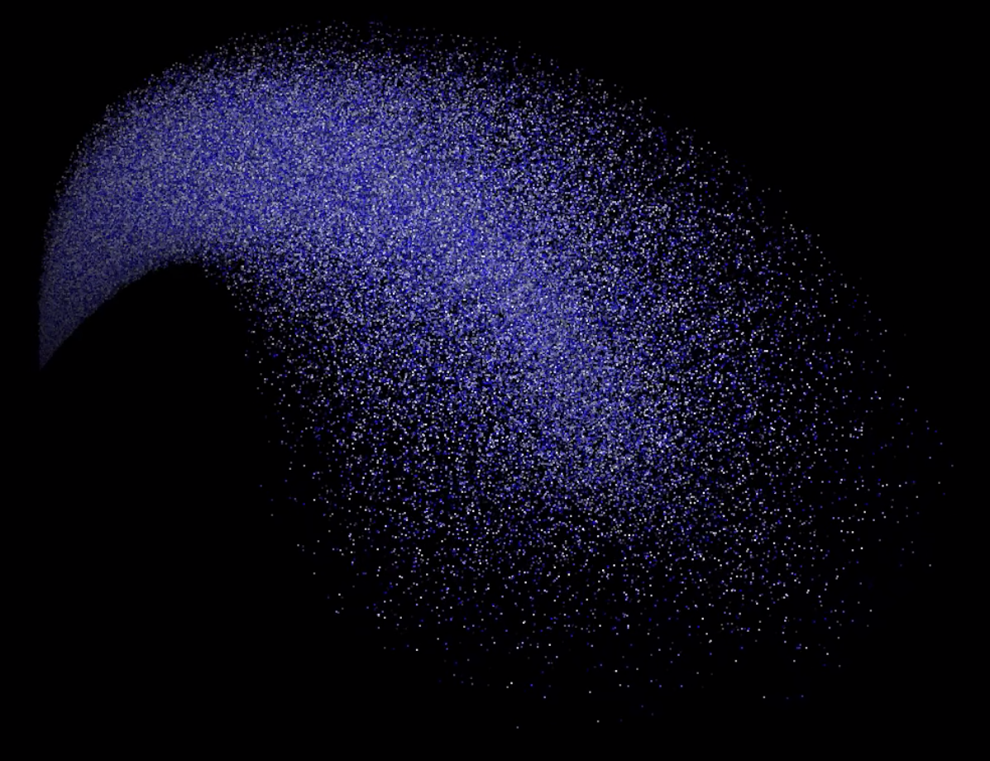
Exploration of Optimisation Techniques for Vulkan-based Particle Systems:
A Retrospective
Robin Wragg

Slide 2
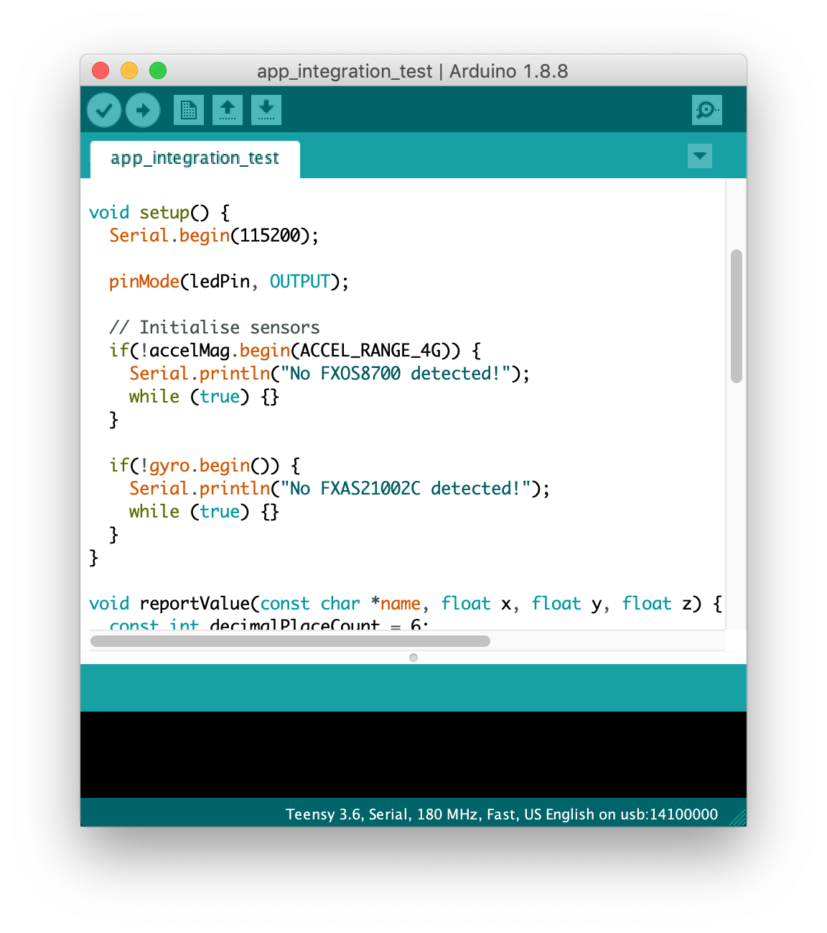
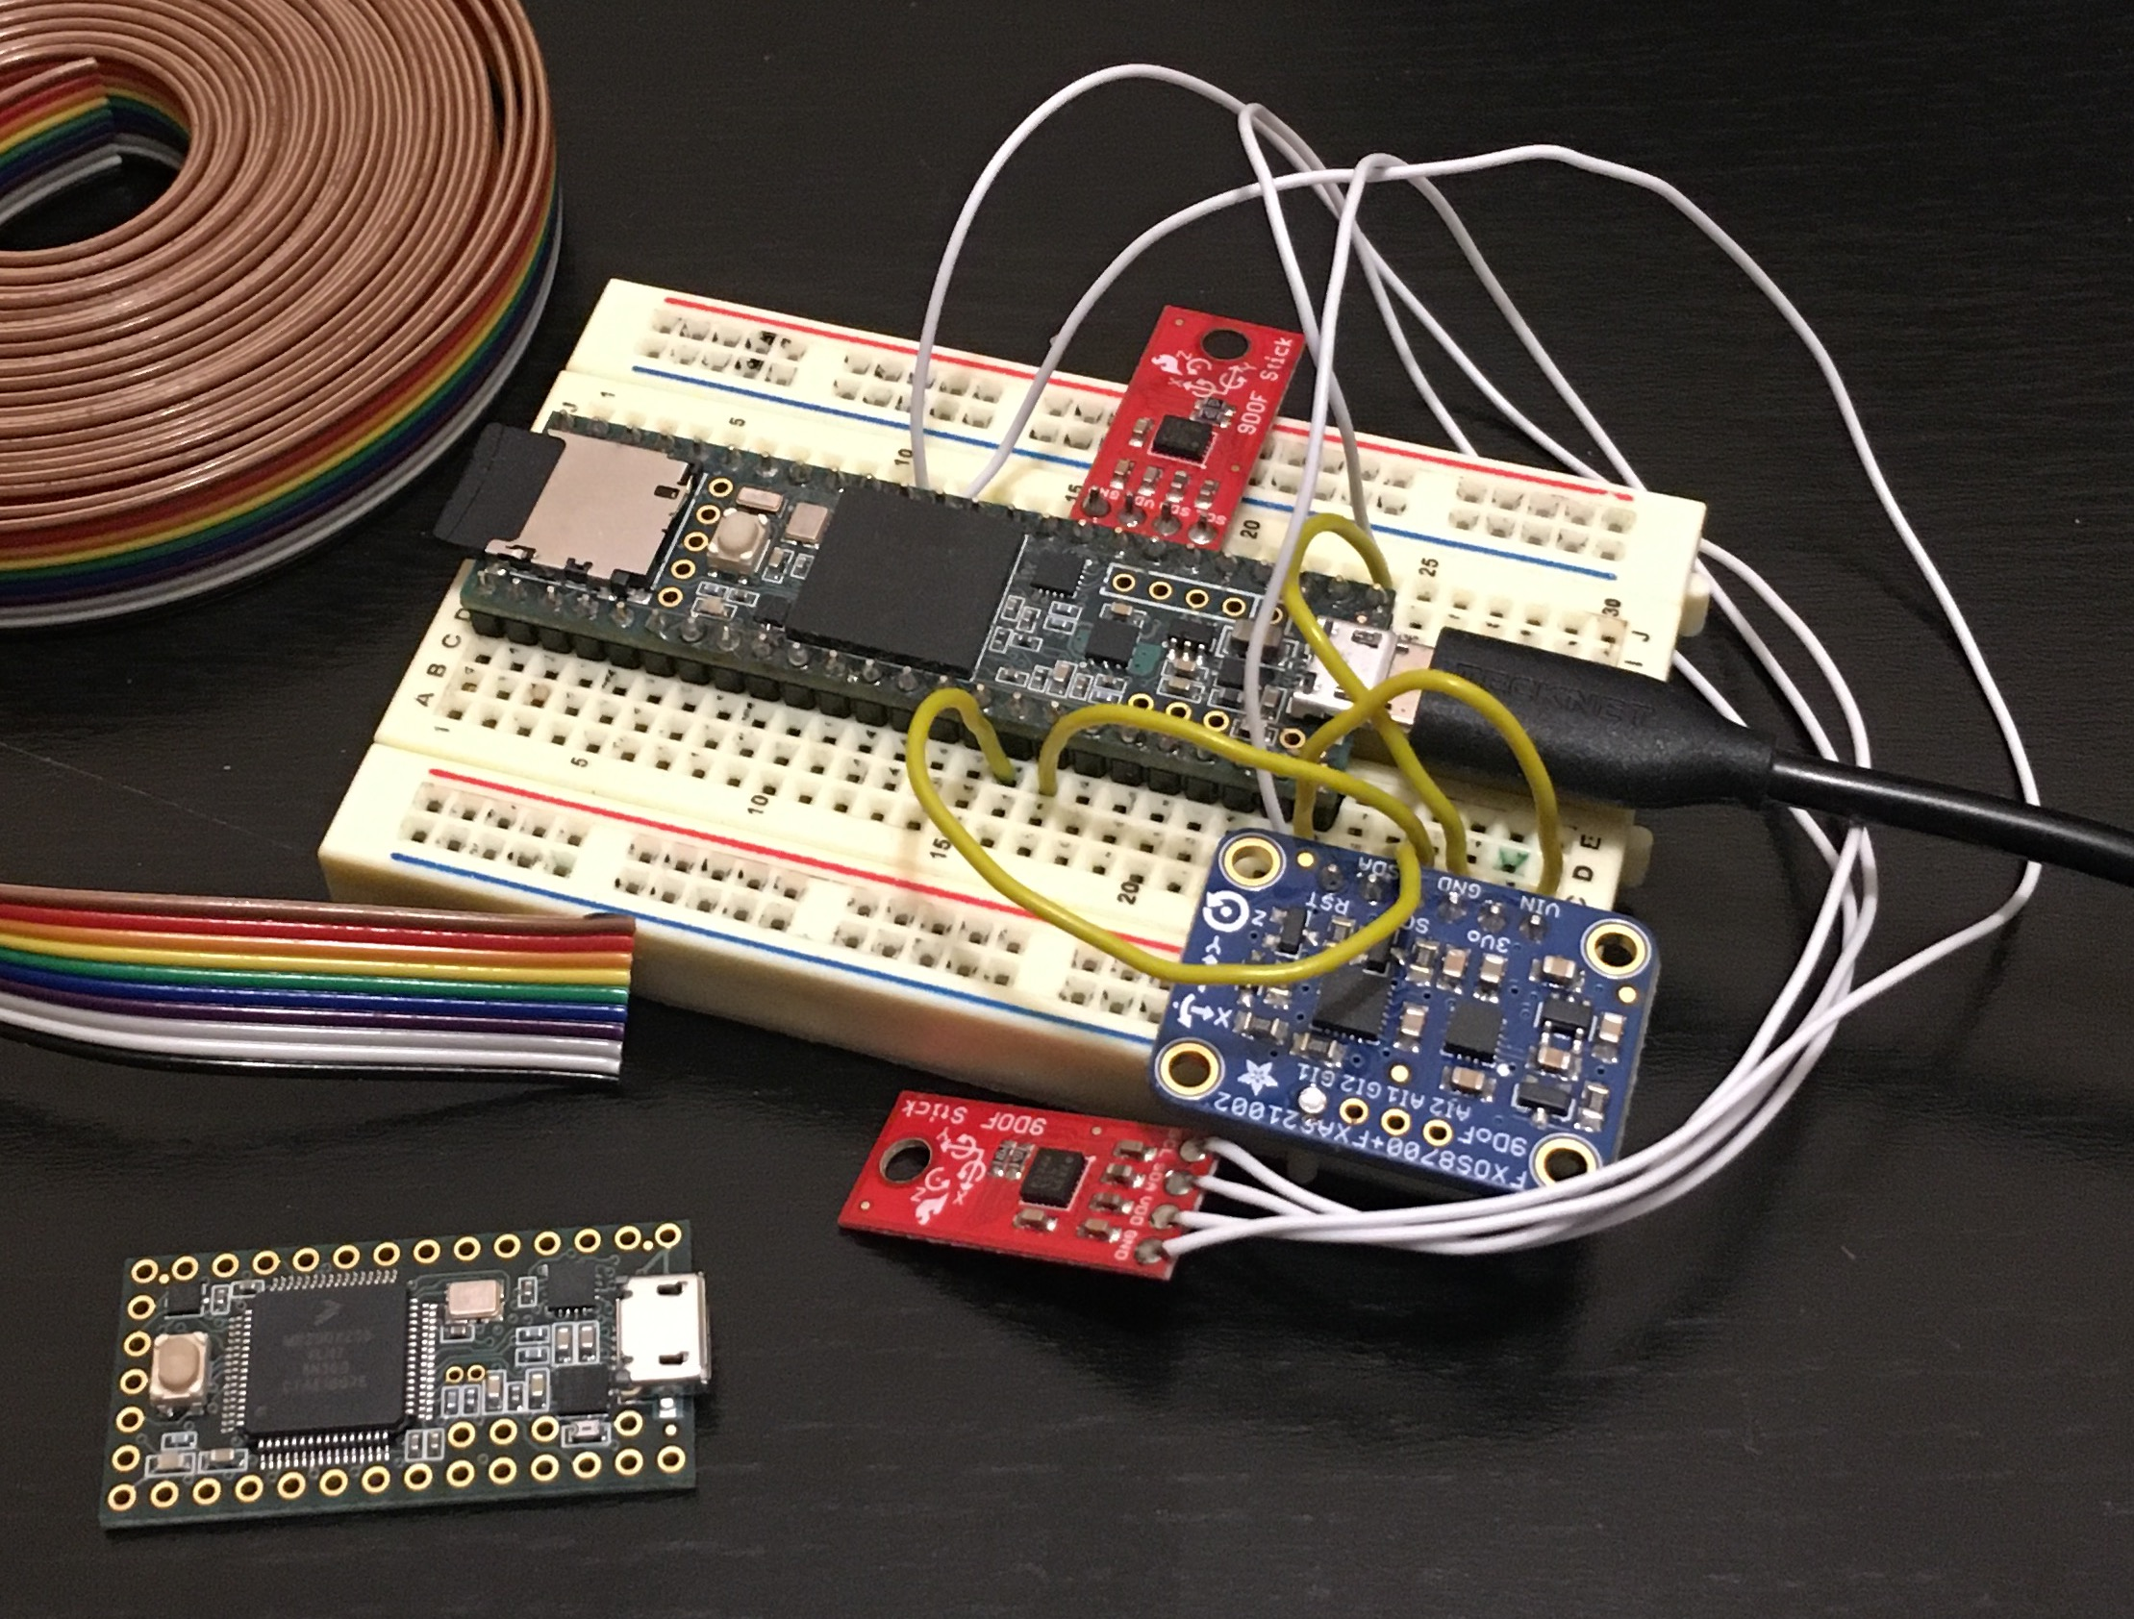
First Project: Motion Tracking
Notes:
Buggy software, malfunctioning hardware

Slide 3
Time Management
Notes:
Obligatory Gantt chart

Slide 4
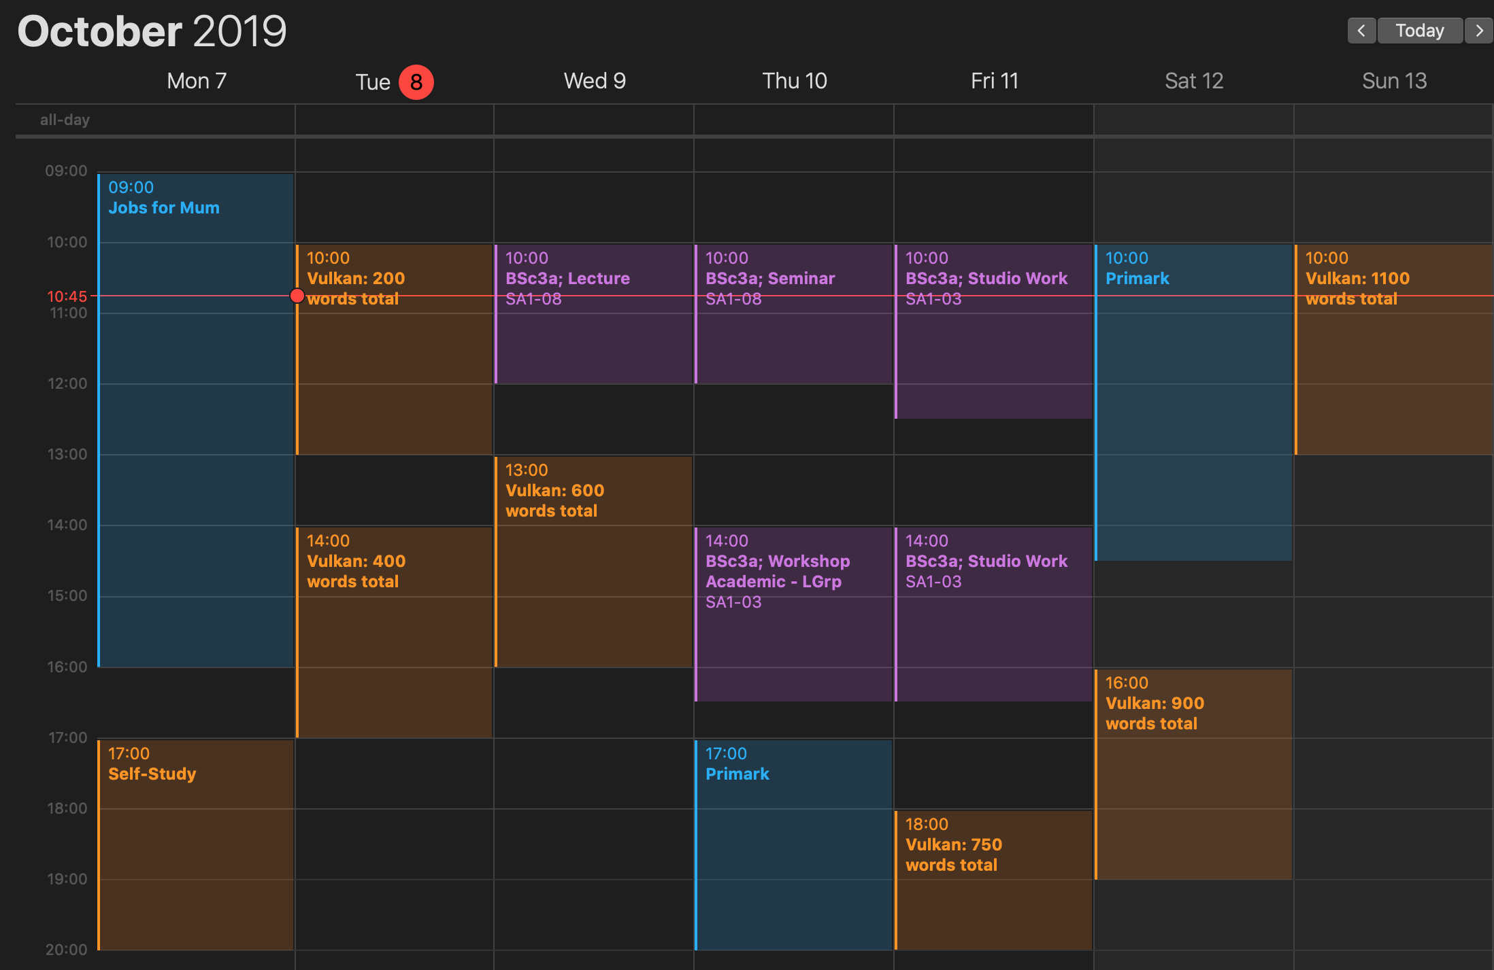
Time Management
Notes:
More detailed time management

Slide 5
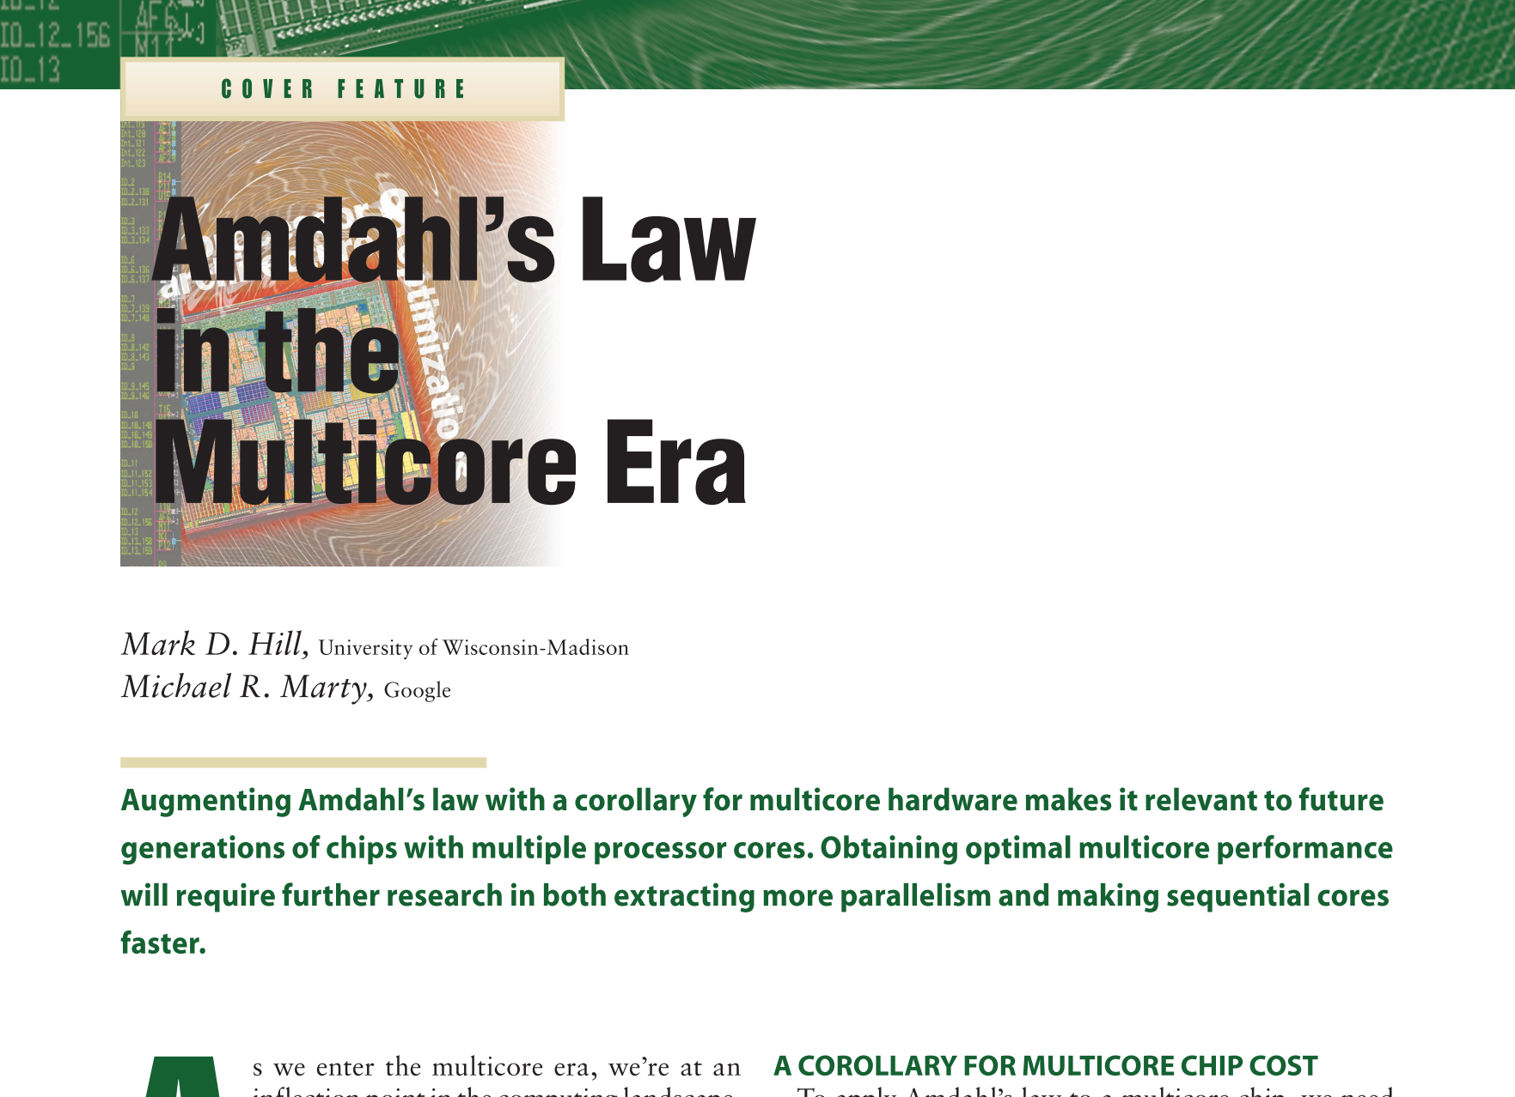
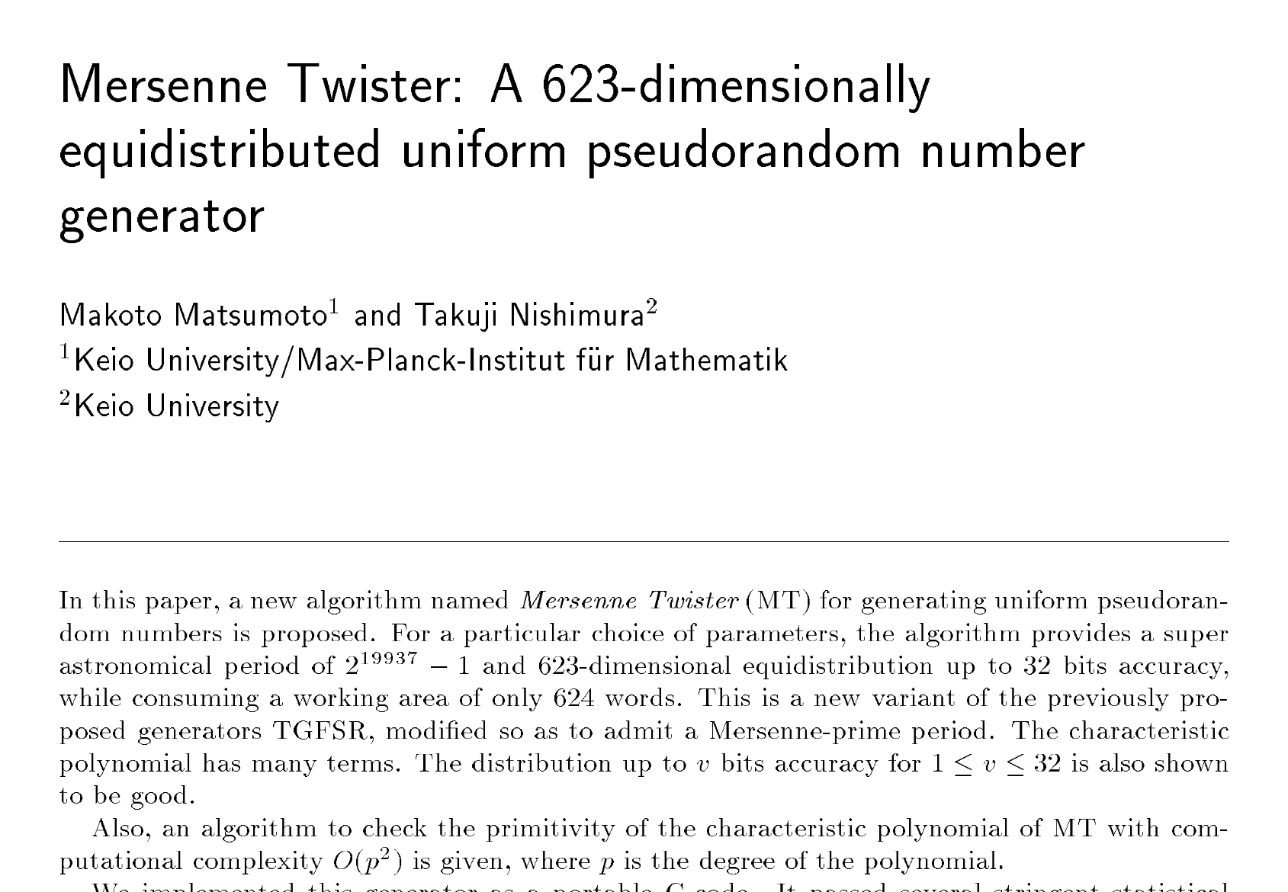
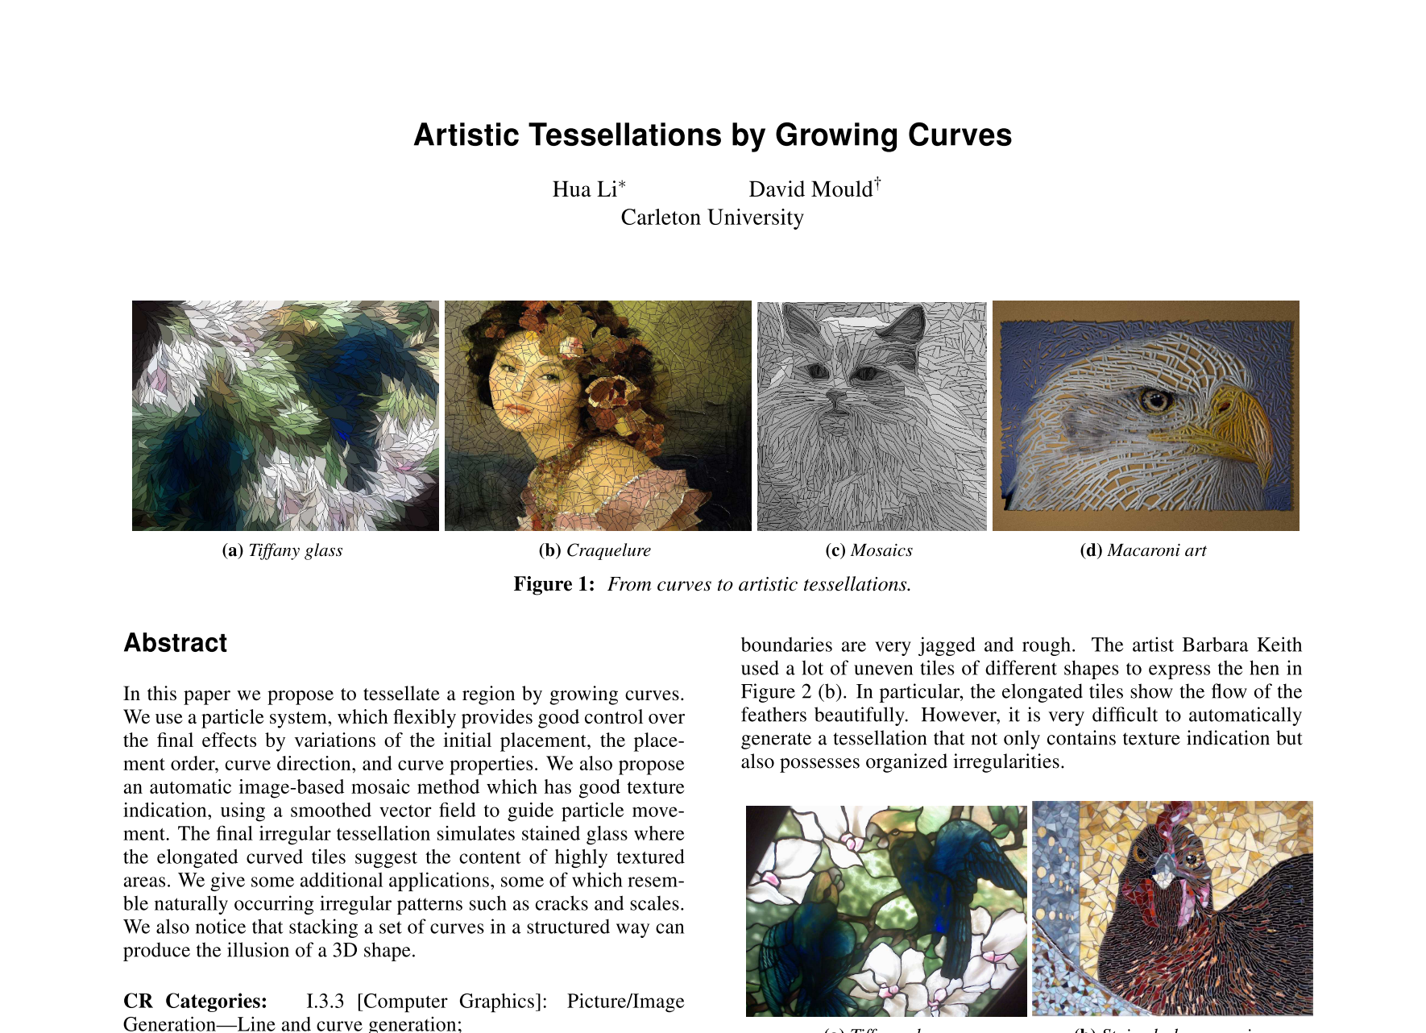
Research
Notes:
High-level concepts llike Amdahl’s Law, Detail-oriented technical implementations like Mersenne Twister, Compute-based artistic creation like Growing Curves

Slide 6
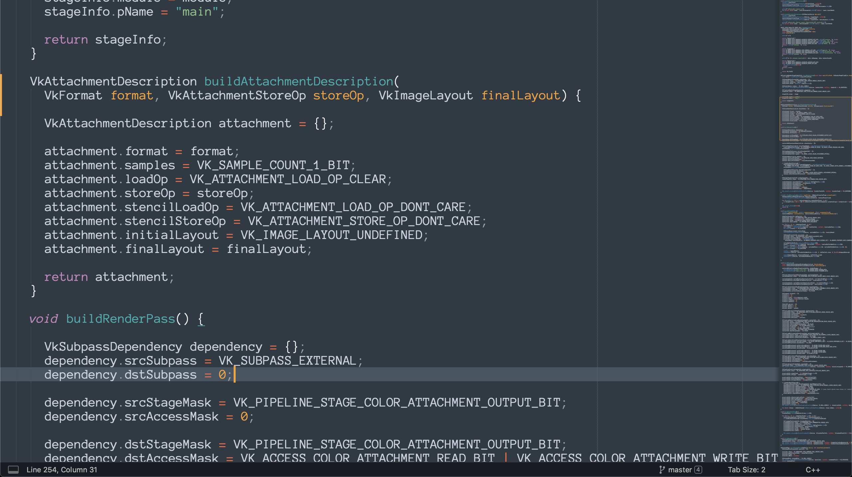
Vulkan API Usage
Notes:
A complex API that is both time-consuming and powerful

Slide 7

The Particle System
Notes:
A simple, velocity-based particle system

Slide 8
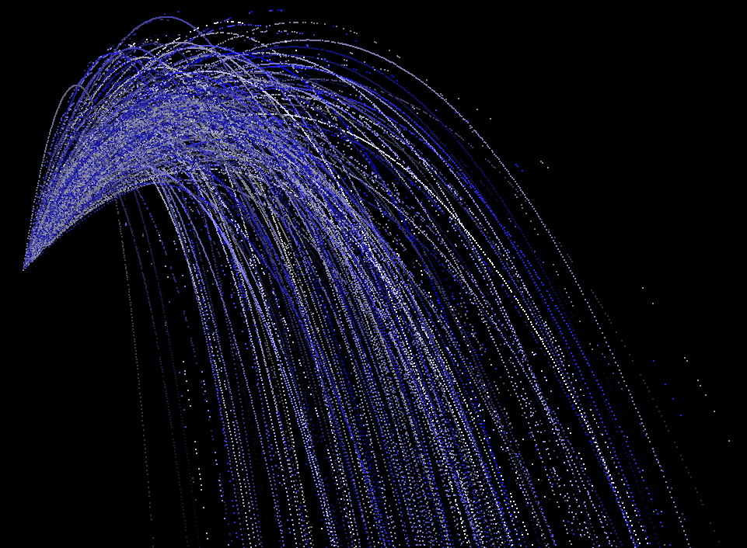
Optimisation
Particle Count vs. Frame Duration
Notes:
Bugs and solutions

Slide 9
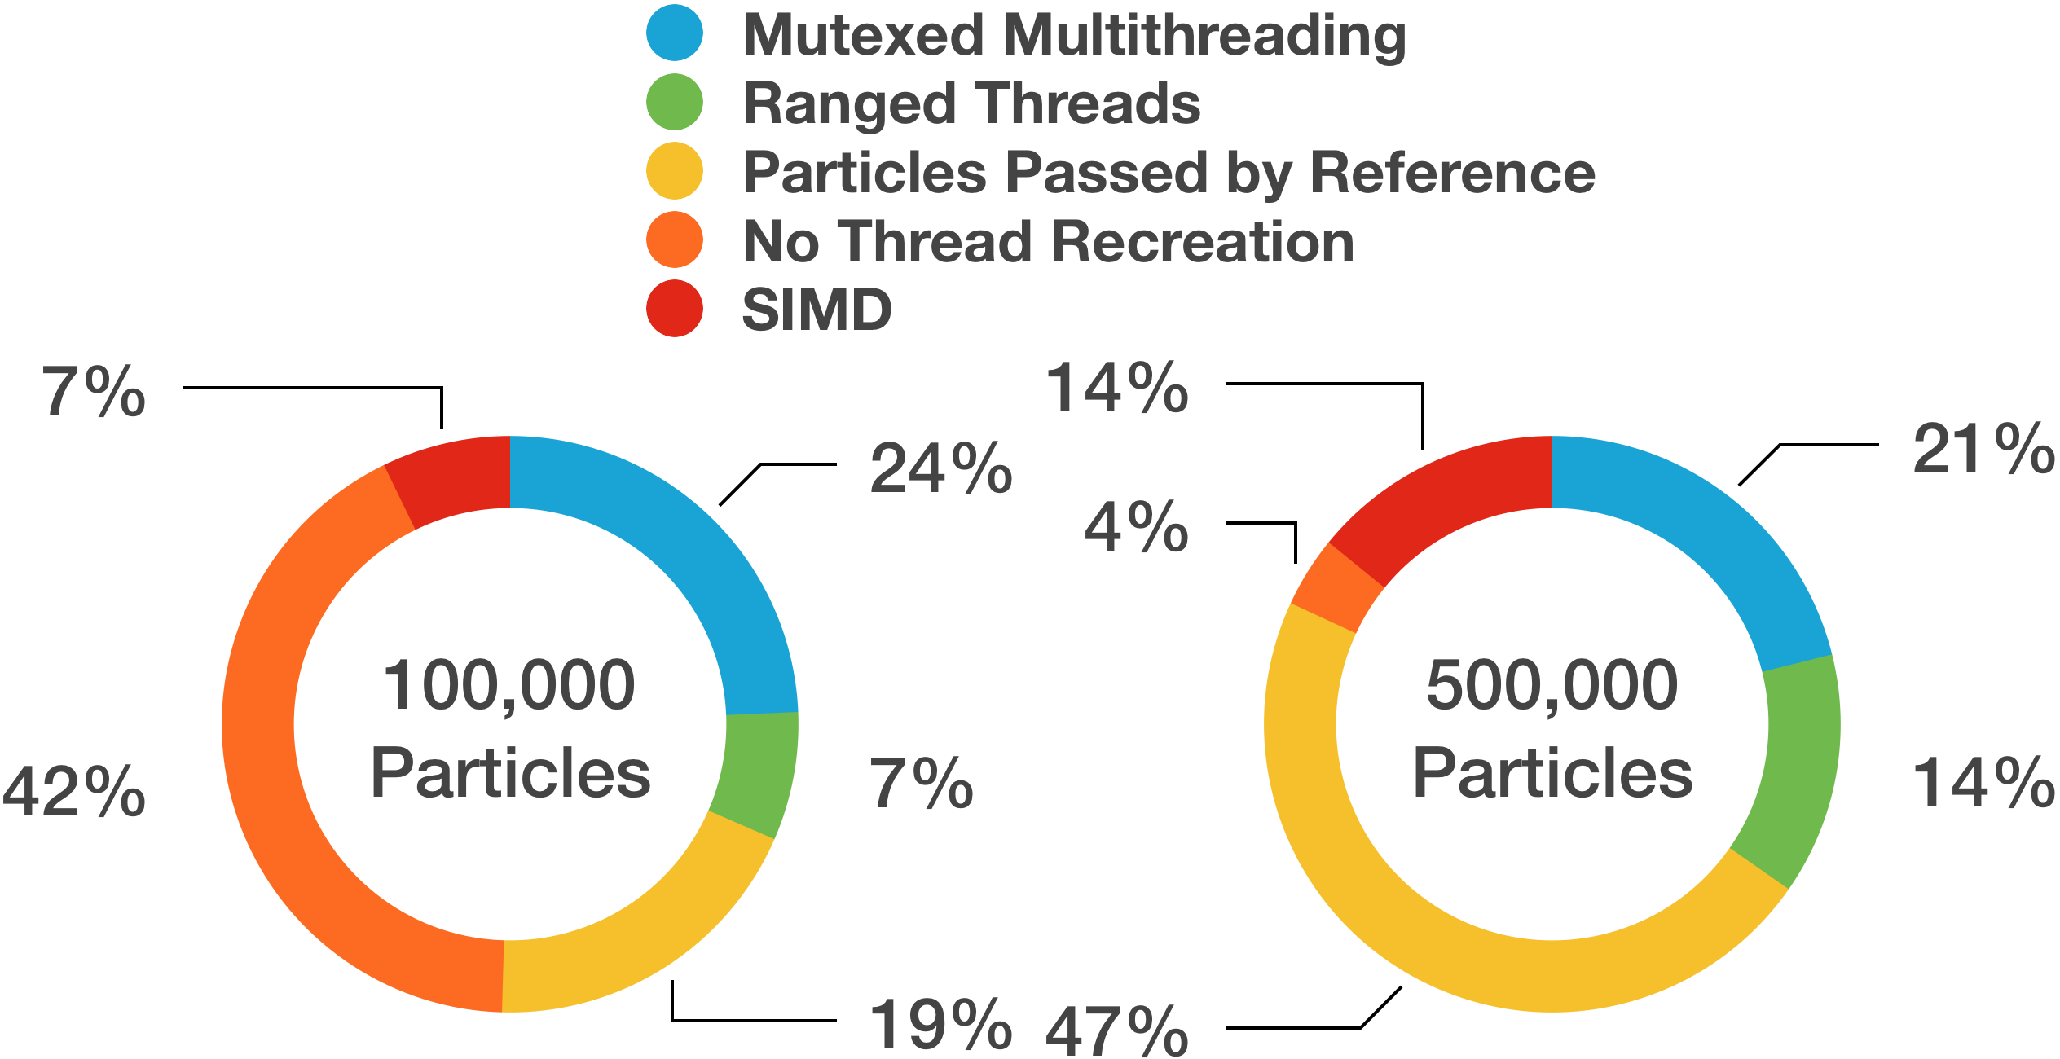
Analysis
Notes:
Speedups related to each stage of optimization as percentages of overall frame duration

